Slide 1




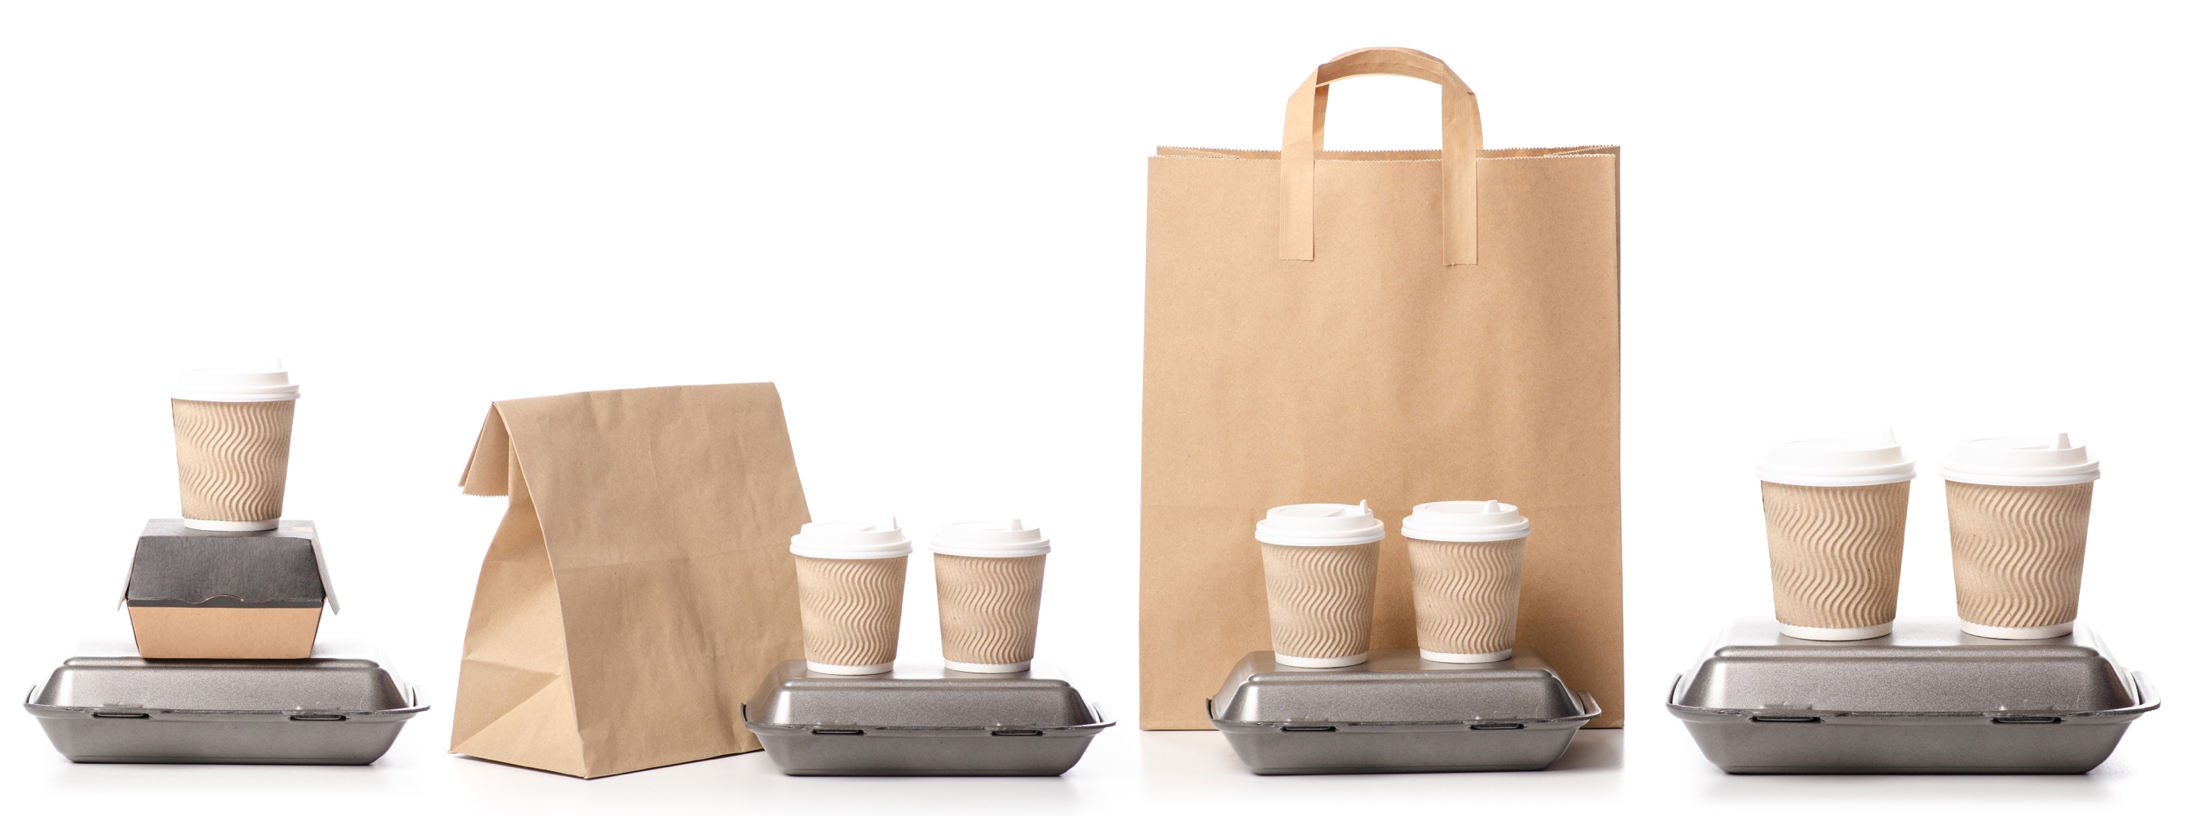

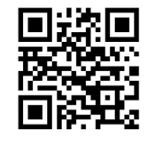
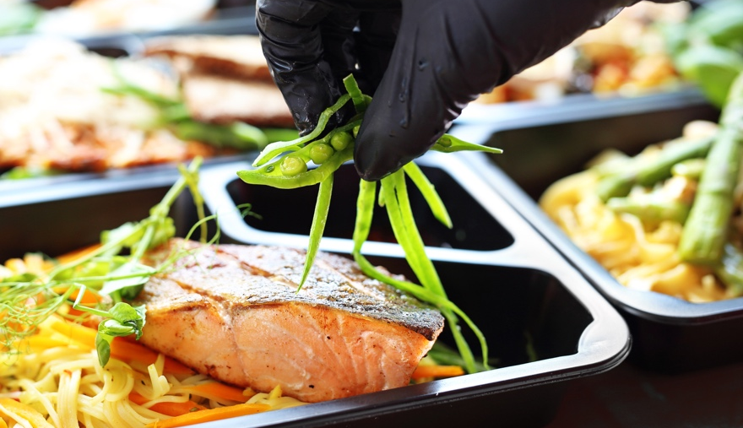

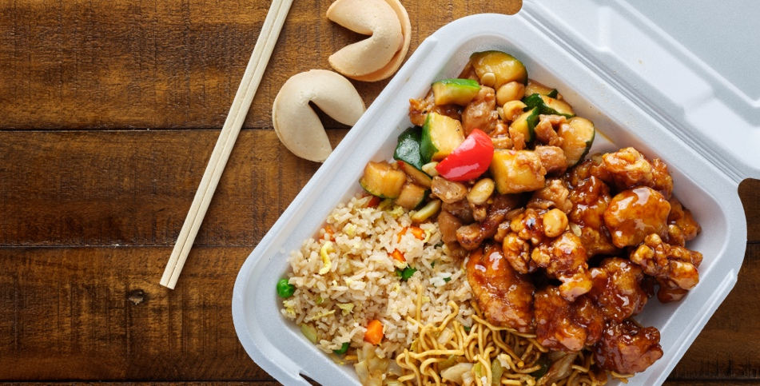


We appreciate all your efforts to support your
friends and neighbors in the restaurant industry.
We're honored every time you choose us, and we promise to do our best to earn your business. #foodservicestrong
Share your pic of takeout on your social media with #takeouttogiveback #teamnokidhungry
and 50¢ will be donated to @NoKidHungry
through May 2020.
Order a family meal for takeout or delivery to help more foodservice workers stay #foodservicestrong.
Share your pic of takeout on your social media
with #takeouttogiveback #teamnokidhungry
and 50¢ will be donated to @NoKidHungry
through May 2020.
From the team at Main Street Café
~ From the team at Main Street Café
You can count on us to do everything possible to keep you safe as we provide convenient curbside pickup or delivery – offering the same delicious, high quality meals that you deserve. Thank you for your support! #foodservicestrong
This has been an unprecedented time for all of us, but together we will make it through. Your business makes a difference. SEE YOU SOON! #foodservicestrong
Share your pic of takeout on your social media with #takeouttogiveback #teamnokidhungry
and 50¢ will be donated to
@NoKidHungry through May 2020.
Share your pic of takeout on your social media with #takeouttogiveback #teamnokidhungry
and 50¢ will be donated to @NoKidHungry
through May 2020.
~ From the team at Main Street Café
From the team at Main Street Café

Slide 2




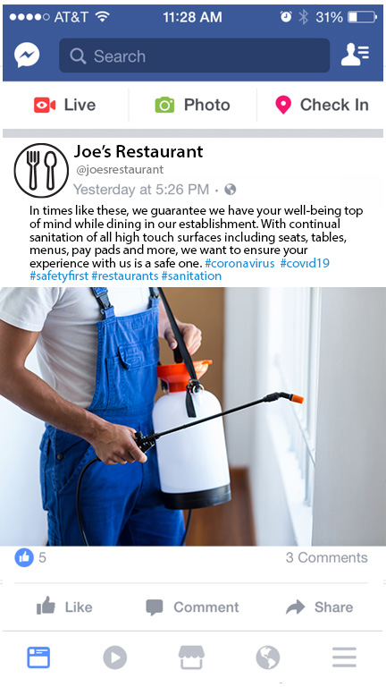
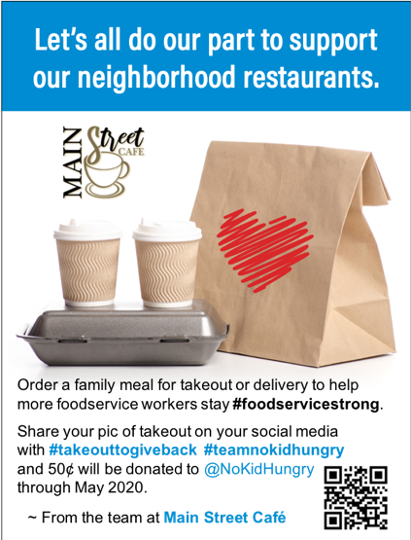




#takebacktogiveback
Social Media Messaging
Create quick and effective social media posts using these sample messages and images – or get creative on your own!
Thanks for your support of our front line workers! This has been an unprecedented time for all of us, but together we will make it through. Your business makes all the difference. SEE YOU SOON! #takeouttogiveback #foodservicestrong
Let’s all do our part to support our neighborhood restaurants. Order a family meal for takeout or delivery to help more foodservice workers stay #foodservicestrong. #takeouttogiveback
Each time you order a meal for takeout or delivery, you are not only supporting a local restaurant like ours, but also the family of foodservice workers who make that business a part of the community. Together we can all help our friends and neighbors in the restaurant industry stay #foodservicestrong. #takeouttogiveback
Restaurants are where you go to celebrate, connect with old friends, and make new ones. These days, while you may not be able to dine-in to enjoy a meal, you can still create those connections by bringing the taste and aroma of our restaurant right to your home. Order takeout or delivery, and help your friends and neighbors in the restaurant industry stay #foodservicestrong. #takeouttogiveback
Mother's day is around the corner, and although you may not be able to dine in with us, we can still help you celebrate Mom! We're offering special Mother's Day family meal pack for easy takeout or delivery. Together we can all help our friends, neighbors - and MOMS - in the restaurant industry stay #foodservicestrong. #takeouttogiveback
We know it's not easy - but your order makes a difference! You can count on us to do everything possible to keep you safe as we provide convenient curbside pickup or delivery – offering the same delicious, high quality meals that you deserve. Thank you for your support! #takeouttogiveback #foodservicestrong
From the bottom of our hearts, we appreciate all your efforts to support your friends and neighbors in the restaurant industry. We're honored every time you choose us, and we promise to do our best to earn your business. #foodservicestrong. #takeouttogiveback
You're our Hero! Every takeout or delivery order you place with us supports all the members of our restaurant family through this difficult time. We know you’re in the same boat - so we're even more grateful for your business. Thank you and until we meet again, stay #foodservicestrong. #takeouttogiveback
Do you know what you just did? You helped feed and support your community. As you know, the restaurant community has been severely impacted – so, your partnership means everything to us! #takeouttogiveback We are your neighbors, friends and family. Thank you, stay safe, and stay #foodservicestrong.
Sure, it'd be more fun to hang out together here at our place – but for now, takeout or delivery is the next best thing! Please know we're making sure your order is as safe and tasty as can be, and by supporting your neighborhood restaurants, you're giving hope and resources to our restaurant community. #taketouttogiveback #foodservicestrong
©2020 All Rights Reserved. Sysco Corporation.

