Slide 1
To thank you for your business,
we’re offering 20% off your future orders through the end of July!
THANK
YOU!

Slide 2
THANK
YOU!
To thank you for your business,
we’re offering 20% off your future orders through the end of July!

Slide 3
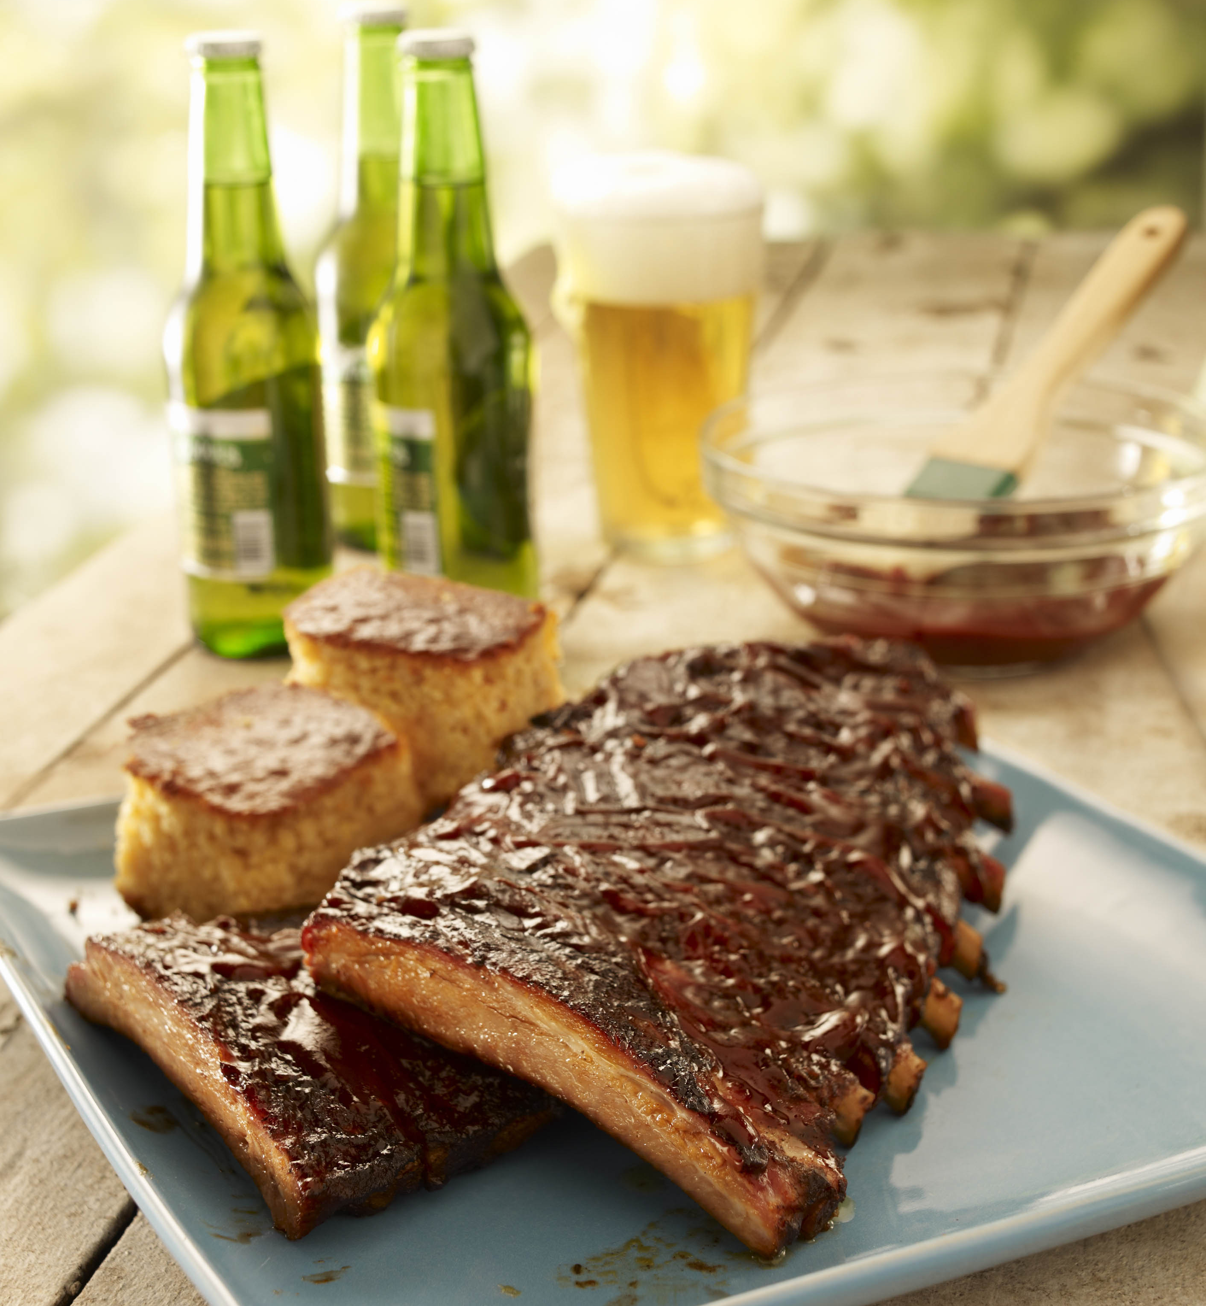
THANK
YOU!
To thank you for
your business, we’re offering 20% off your future orders through
the end of July!

Slide 4
THANK YOU!
To thank you for
your business, we’re offering 20% off your future orders through
the end of July!

