Slide 1
CURBSIDE PICKUP
& DELIVERY
PHONE # | WEBSITE

Slide 2
CURBSIDE PICKUP
& DELIVERY
PHONE # | WEBSITE

Slide 3
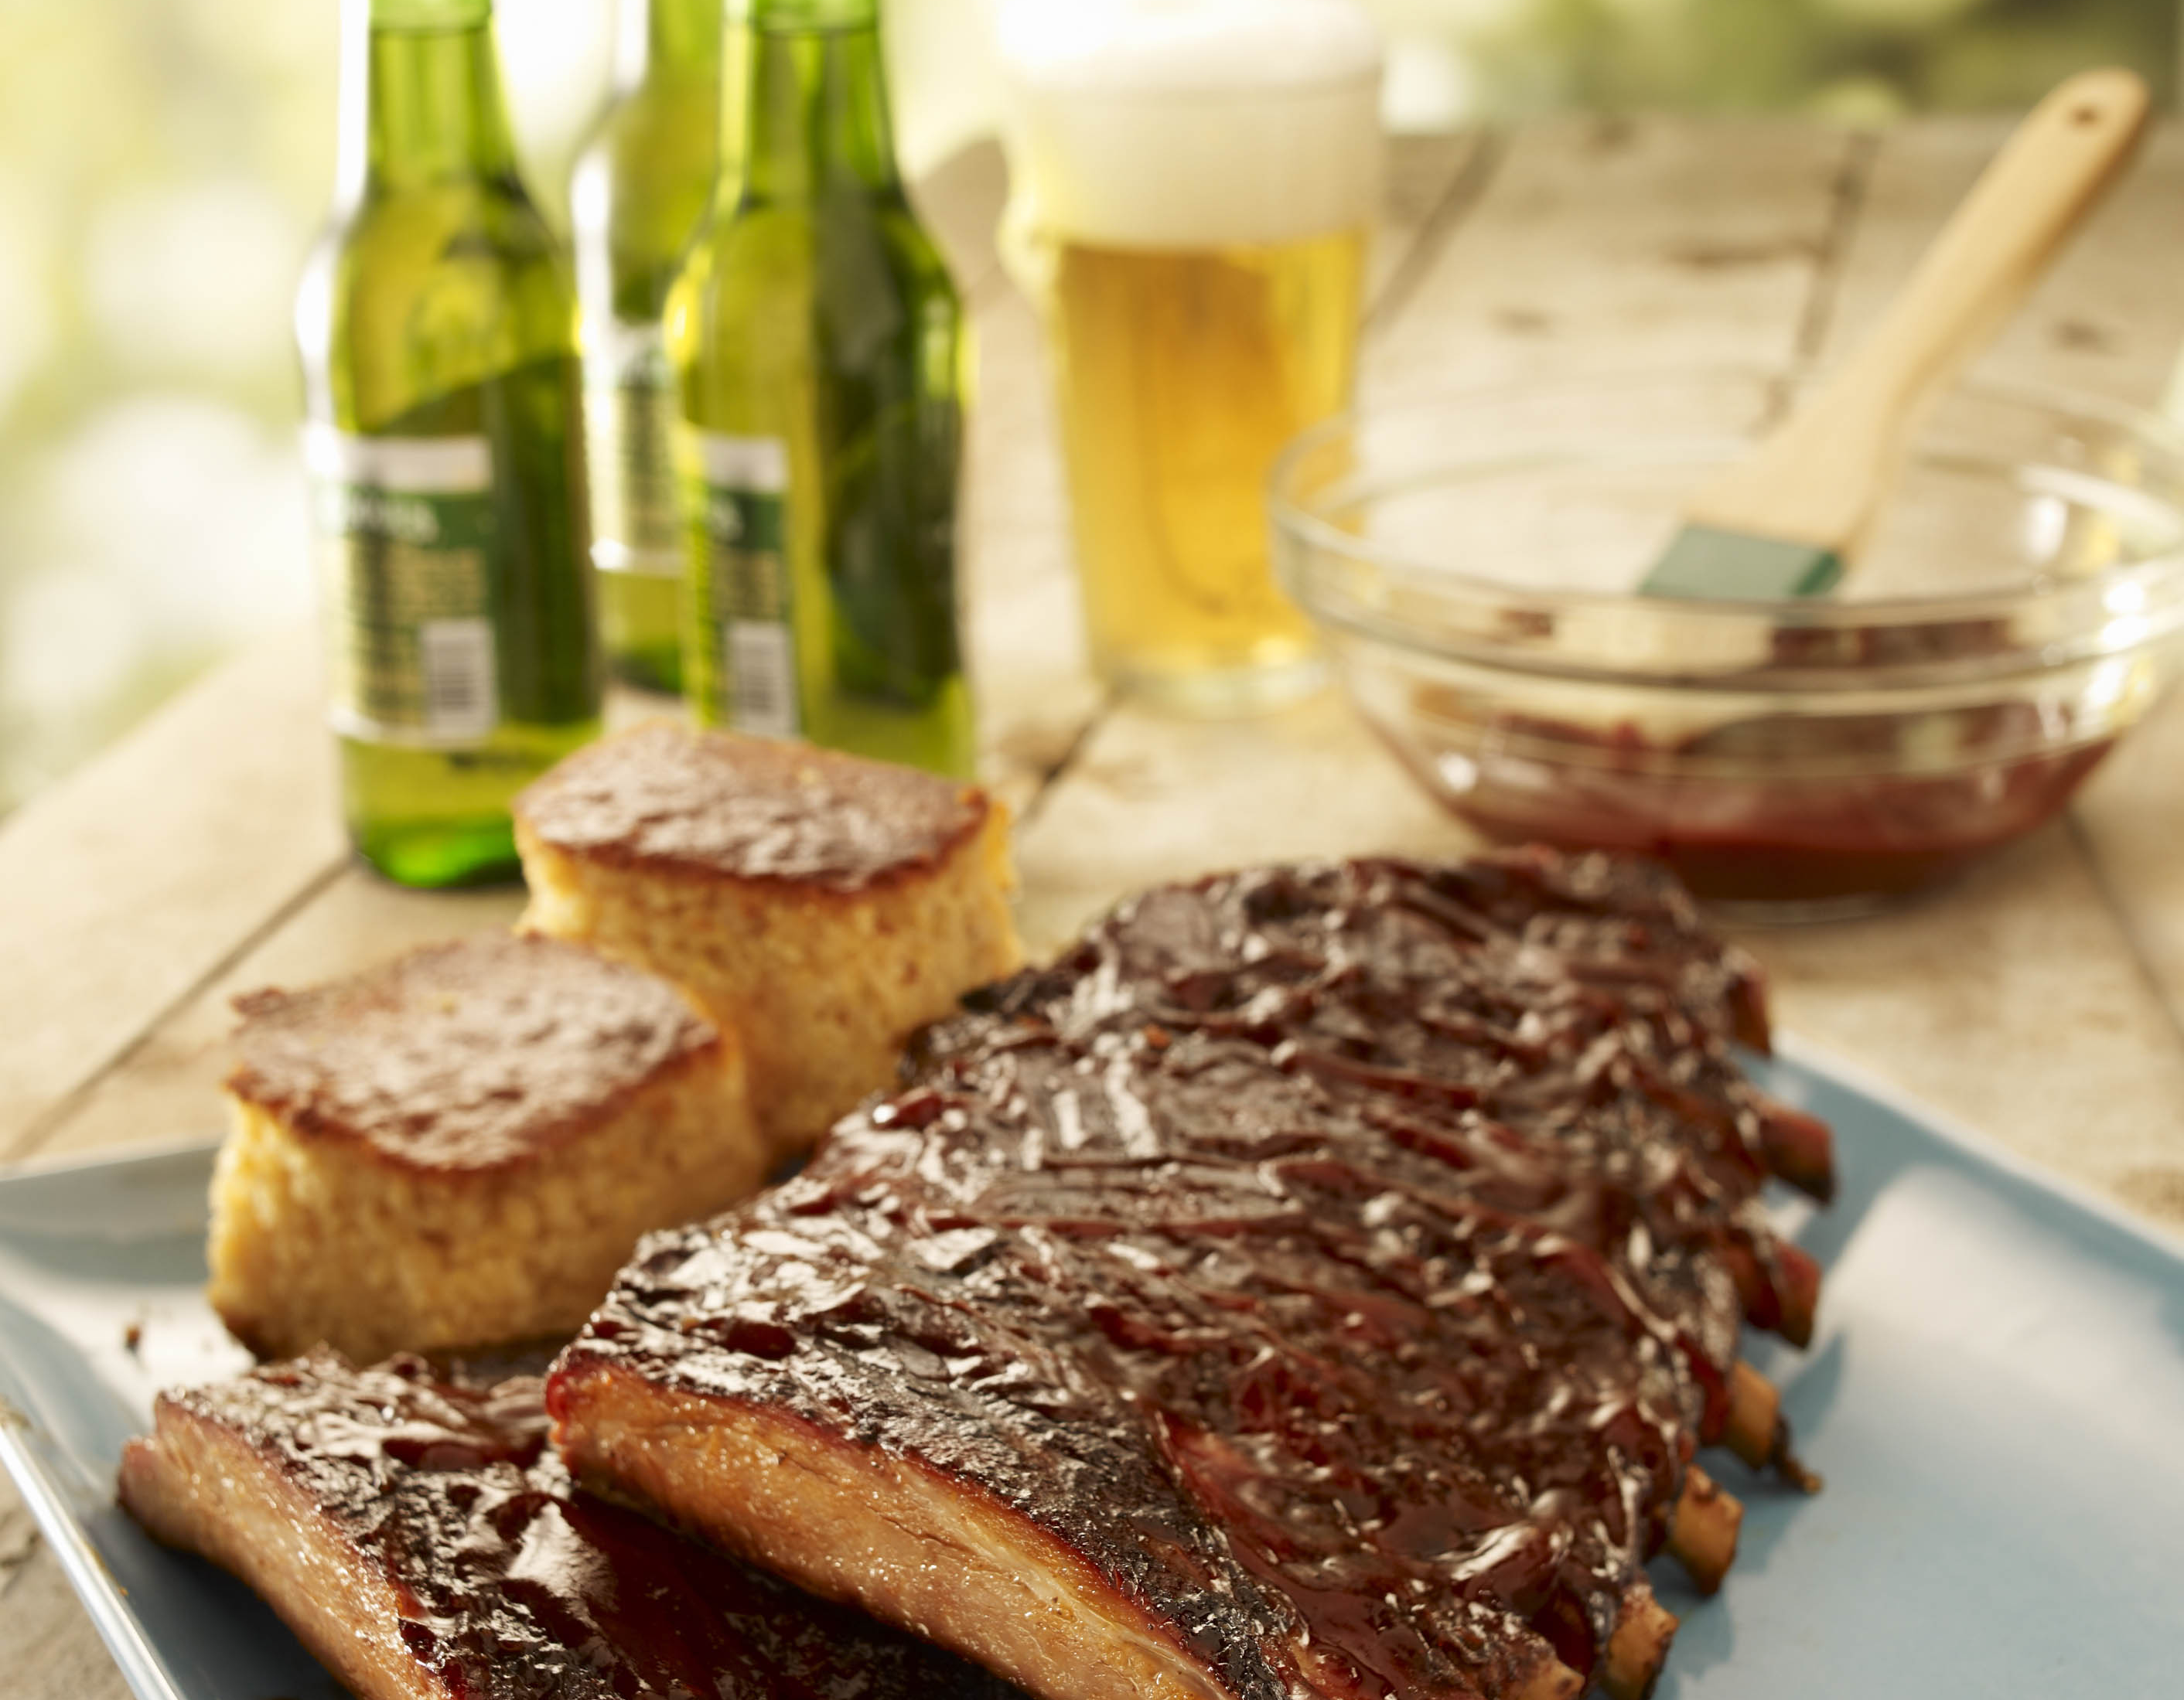
CURBSIDE PICKUP
& DELIVERY
PHONE # | WEBSITE

Slide 4
CURBSIDE PICKUP
& DELIVERY
PHONE # | WEBSITE

